Slide 1
Don’t worry.
Don’t let us down
I don’t know, but I expect we can find out if we work on it together.
You’ll be all right. Your brother and your Dad and I did ok in our exams….

Slide 2
Supporting your Y11 towards 8s and 9s
Mrs Eleanor Norman
Stretch and Challenge Coordinator

Slide 3
The system:
Pupils will have 20+ exam papers ranging in length from 1 to 2 hours.
These will be spread over as much as 6 weeks (depending on subjects taken).
Every subject has at least 2 papers. Some, eg Geography, have three.
In science, both triple and double awards have 2 exams per subject. The triple exams are longer.
Since COVID each subject has its papers spread apart by at least a week, so that if a pupil is ill for one, they should be able to sit the other.

Slide 4
8 and 9
These are the top 2 grades.
Under the old system A* = current 8, not 9.
Level 8 comes from students demonstrating the skills described in the top band of each subject’s mark schemes.
Level 9s are awarded after the papers have been marked, using statistical measures.
3-5% of students nationally are awarded level 9, depending on the the ability profile of the cohort suggested by their results in Y6.
Y11 are the second year who didn’t sit SATs in Y6 because of COVID.
These exams will be the first experience they have of being judged in a national context.
How useful IS this?

Slide 5
Preparation.
Mocks are w/c 9th Feb, week off for half term, and w/c 23rd Feb.
This will replicate the conditions around may half term, with students able to strategise about when to revise for each exam.
Mocks: useful to determine
Which revision strategies work
How much time spent revising yields results
Whether a student has the materials they need
How much revision is enough
How it feels in an exam venue
How to manage time in the exam
No watches in the exam. There is a digital display in the main hall, and analogue clocks in the smaller venues. Can your child tell the time?

Slide 6
Preparation
Lessons until the start of May
Students need to be taking notes carefully to help them find material later.
Students need to talk to staff, who will be delighted to help resolve questions, issues etc.
If students are off ill, they will need to identify a peer in the class who can fill them in on the work that’s they’ve missed.
After the Easter holiday, students will have no more than 16 school days before the exams start. There are 4 weeks between Easter and half term, but two of these don’t have Monday.

Slide 7
Revising – creating the timetable.
Sit down with your child and work out how much time they actually have. Include:
Easter holidays
after school for the 16 days between Easter and May half term
May half term
time during exam leave after May half term
Aim for a maximum of 6 hours, divided into 3 subject sessions on a non-school day, and 2 hours on a day when they have school.
Schedule breaks – at least a day per week in holiday times.

Slide 8
2) Decide how to split the time available between the different subjects. Consider:
experiences from mock exams
subjects that are going to continue at A-level
There are NO subject exams for which revision is not necessary!
3) With a calendar, allocate slots up to the time that you have decided to spend on each subject, bearing in mind when each paper is. Colour coding is useful.
4) Fine tune the timetable with which topic is going to be studied in which slot.
5) Prepare to be flexible. Life will happen. But if a slot is missed, help your child to work out how they can get back on track.

Slide 9
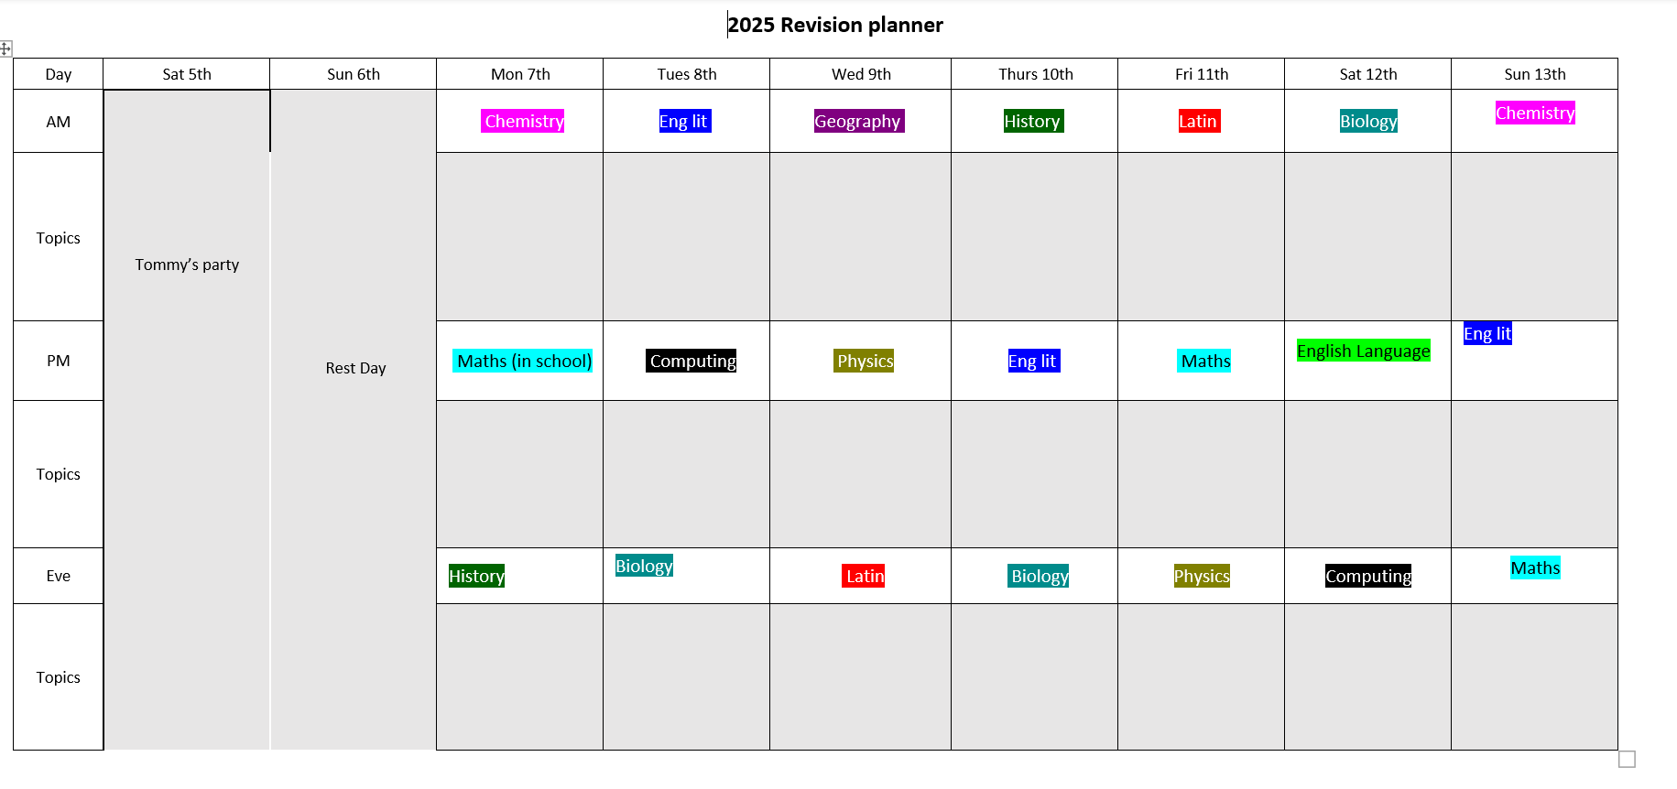
Example of a revision timetable – first week of Easter Holidays

Slide 10
Revising – creating the conditions.
At the start of Easter assemble ALL the materials:
Exercise books
Marked work
Revision guides
laptop
Buy twice the number of flash cards that you think you’ll need.
Create a space in the house where your Y11 can spread out, and where their materials can be largely undisturbed.
Music MIGHT help. The TV definitely won’t and it would be better not to have one in the room.

Slide 11
Refreshment
Can you help your Y11 to have a really good lunch each day? Planning and preparing it might be an incentive.
Can you have something distracting in the garden or garage – badminton, football net, exercise equipment: anything to make up for the fact that it’s not great for a growing child to sit still for hours on end, and they have just stopped doing compulsory PE.
Are there safe and reliable walks that your child can take themselves on to unwind?

Slide 12
Make sure that the internet connection is reliable.
Establish good habits with phones. Research shows that having a phone next to you, even on silent, is a distraction when you are working. Try it yourself, and you will see.
It is better to carry out research on a laptop than on a phone during the revision stage.
However, sometimes there are valid reasons for having the phone in the room: recording is one of them.

Slide 13
Revising – using the family.
It is worth communicating carefully with all the family about exactly what your child is undertaking.
Grandparents:
Can be good for lending perspective…
Can help with being a presence in the house if you have to work.
Can take other children out of the equation.
Siblings:
Might be able to lend advice.
Might be a welcome distraction.
Might be an unwelcome distraction!

Slide 14
Revising – methods for sessions.

Slide 15
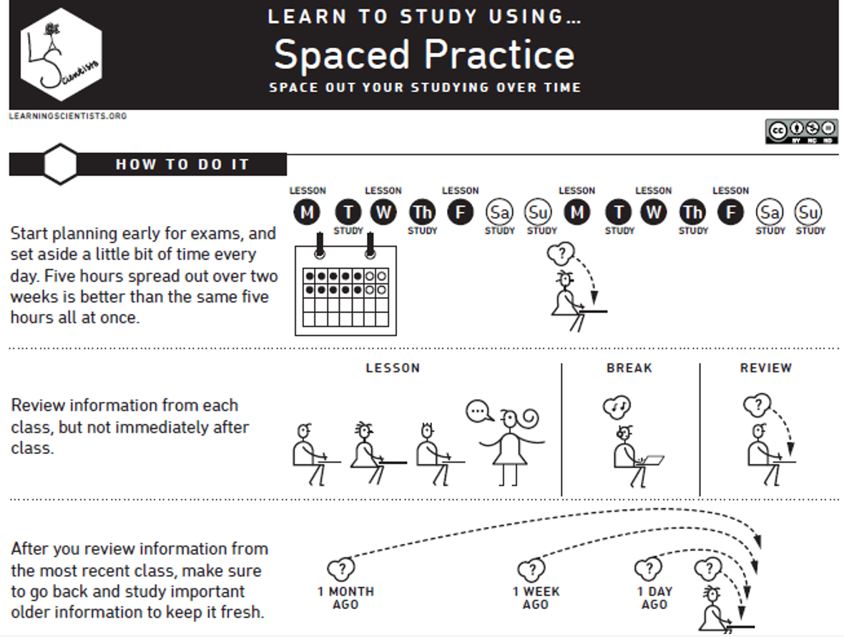

Slide 16
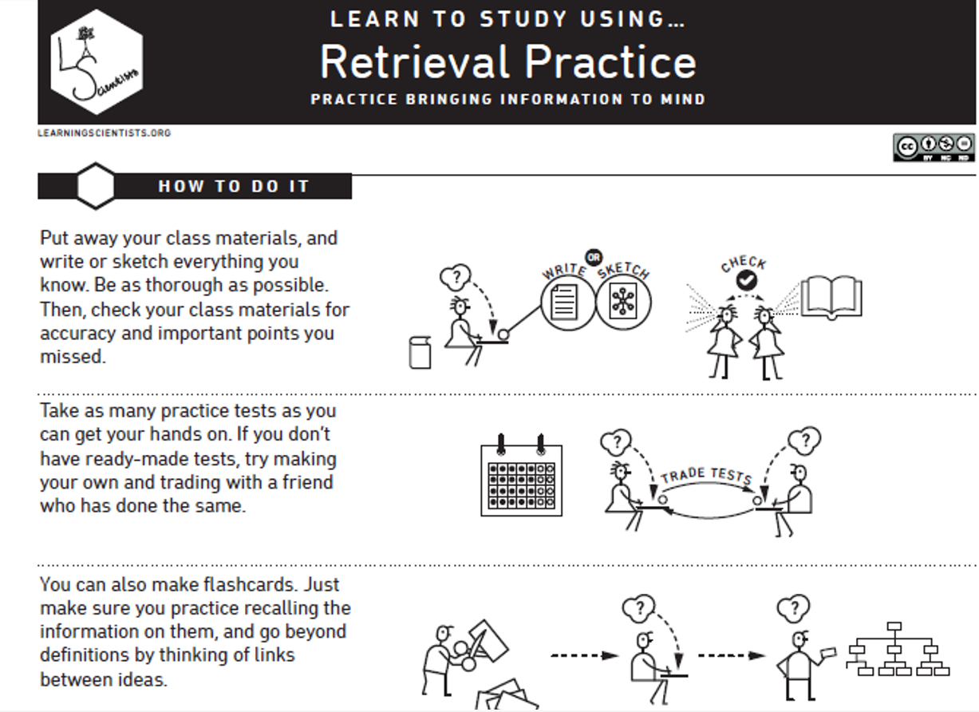

Slide 17
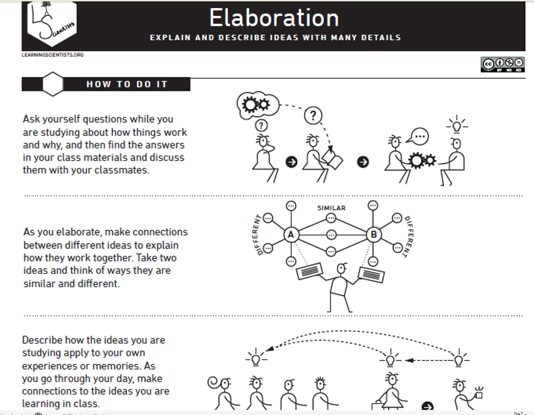

Slide 18
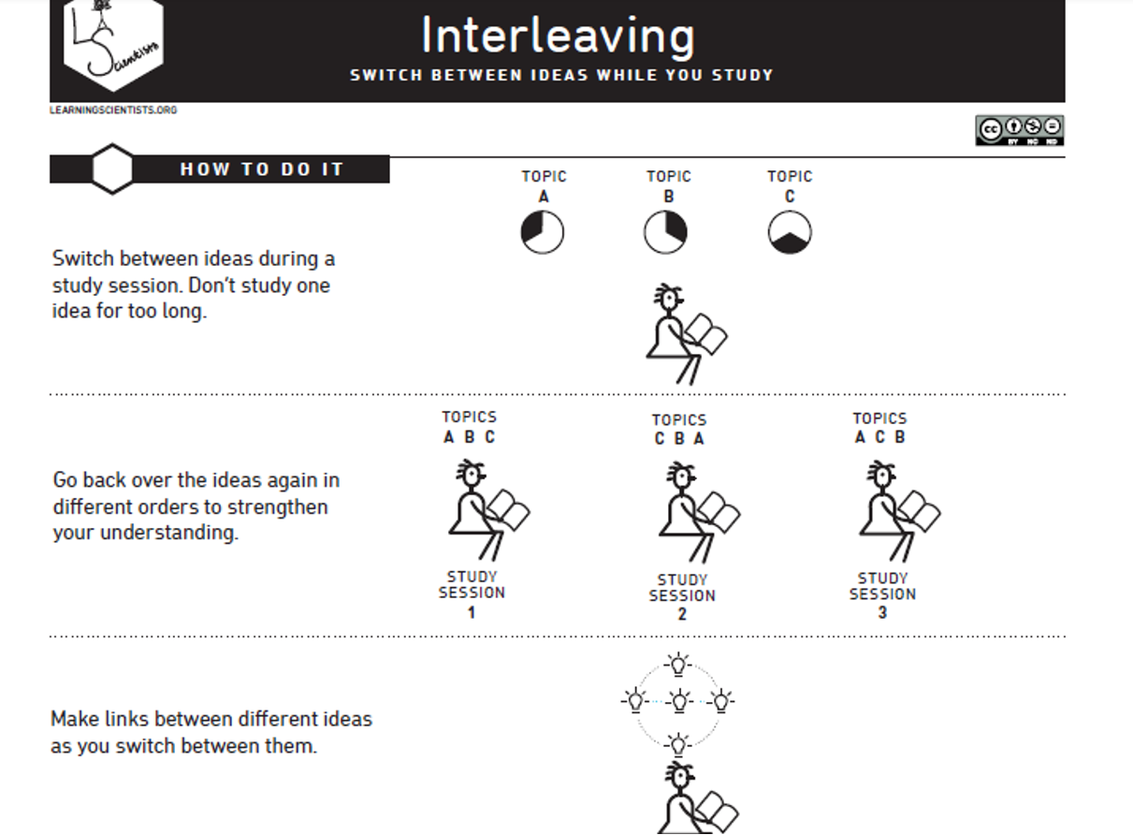

Slide 19
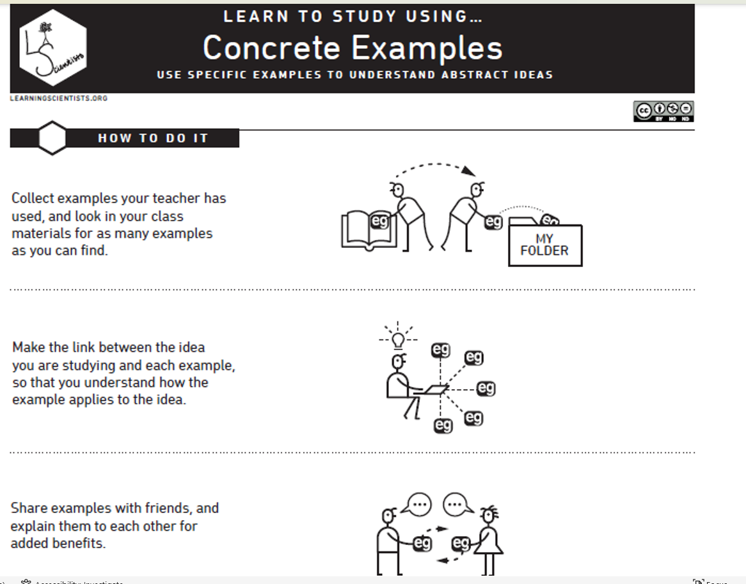

Slide 20
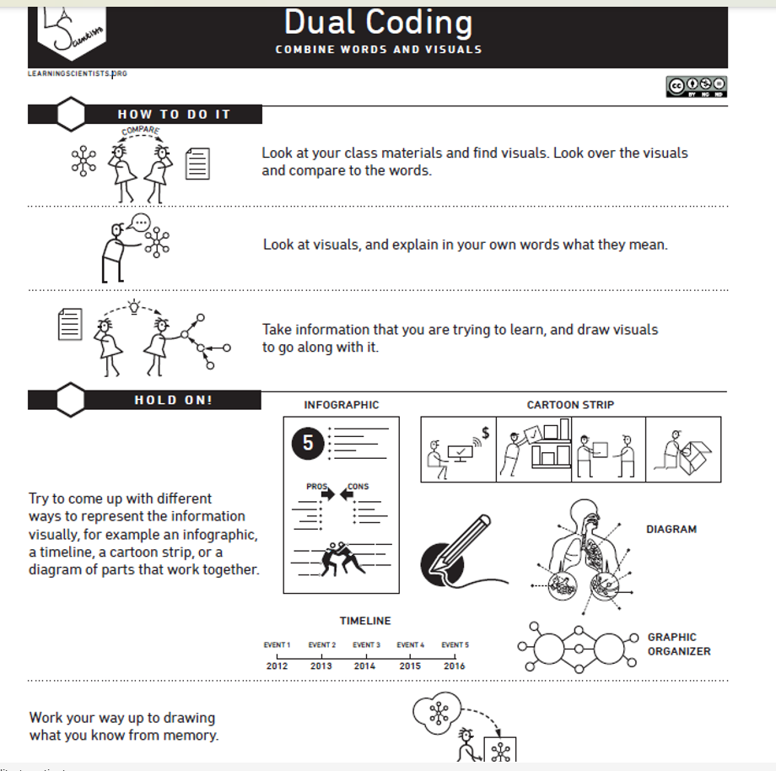

Slide 21
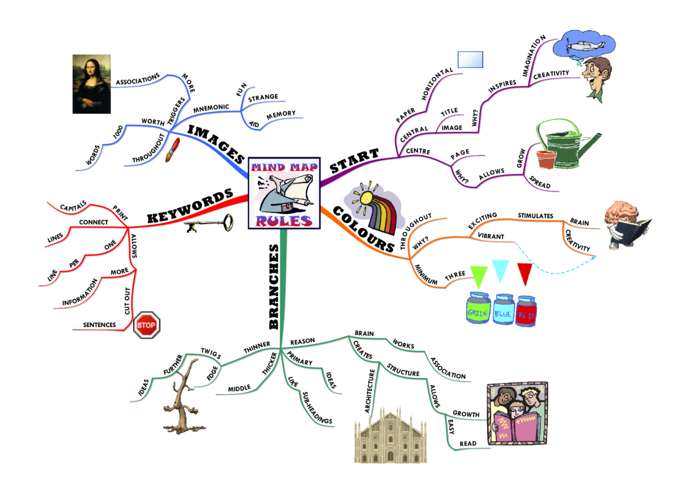

Slide 22
Revising: using AI
Be as precise as possible:
Eg on Chatgpt
What are the important topics to revise for Macbeth for AQA GCSE English Literature for a student aiming for level 8?
Be prepared to be sceptical and consider whether what you are reading sounds right.

Slide 23
During the exams…
Maybe don’t ask for a dissection of each paper afterwards. When it’s done, it’s done.
Keep up the food/exercise/sleep support.
Keep perspective. Life will happen.

Slide 24
Help:
https://www.combertonvc.org/parent-and-student-information/year-groups/year-11
Your child’s subject teacher.
The head of department.
Your child’s form tutor.
The head of year.
Their peers and their peers’ parents.
Please look out for Mrs Roberts weekly briefing which is emailed home.

Slide 25
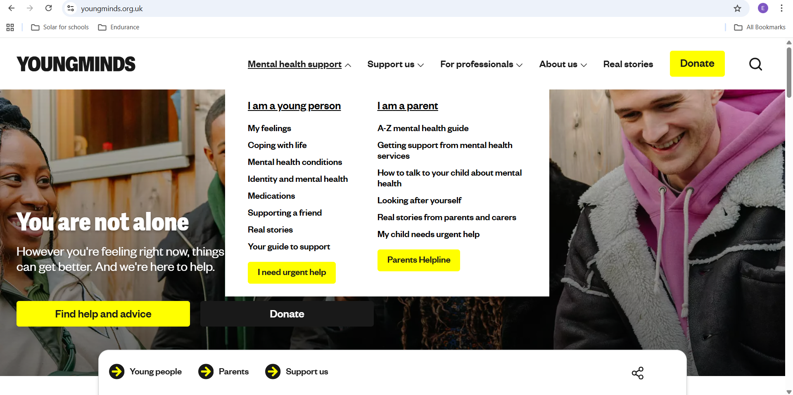

Slide 26
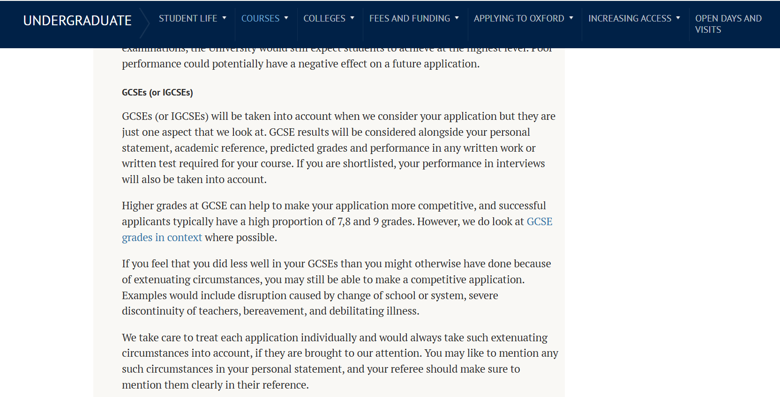
In context: what’s it all for?
From the Oxford University Website.

